Slide 1

Big 5 Stock Trends
By: Keyur Patil, Sydney Robertson, Katrina Smith, Scooter Smith, James Williams
From 2009-2019

Slide 2
The Big 5:
OVERVIEW:
Apple (APPL)
Google (GOOGL)
Microsoft (MSFT)
Facebook (FB)
Amazon (AMZN)
Review NASDAQ data for the big 5 from 2009-2019
Which stock is the best to invest in:
Short term
Long term
Compare & contrast the big 5 with the Nasdaq as a whole
Notes:
Define the core message of your project

Slide 3
Our Questions
trends over the last 10 years
Which of the big 5 was the best investment over the last 10 years?
Which of the big 5 was the worst investment over the last 10 years?
Which of the big 5 was the Most consistent over the last 10 years?
Are there yearly events that contribute to stock volatility?
Are these regularly reoccurring?
Are there general good times to buy and sell the big 5 throughout the calendar year?
Did the big 5 outperform or underperform the NASDAQ composite as a whole over the 10 year period?
Of all the shares bought in the big 5, who had the most shares bought over the last 10 years?
What are the closing prices for the big 5 going to be on Aug 31st 2020?
How does the prediction compare to the actual prices they were this year?
Notes:
Describe the questions you asked, and why you asked them
Describe whether you were able to answer these questions to your satisfaction, and briefly summarize your findings
Describing what kinds of data you needed to answer them, and where you found it

Slide 4
Cleaning the data
Problems: •Stock data dated back to 1971 (only needed Last 10 years) •Stock data was by date (needed to aggregate and sort data) •Stock data was independent and unsorted (needed to group data and organized there within) Insights: •For Loops aren’t always the best way to cycle through large amounts of data •Sometimes a simple merge by value is all you need
Notes:
Describe the exploration and cleanup process
Discuss insights you had while exploring the data that you didn't anticipate
Discuss any problems that arose after exploring the data, and how you resolved them
Present and discuss interesting figures developed during exploration, ideally with the help of Jupyter Notebook

Slide 5
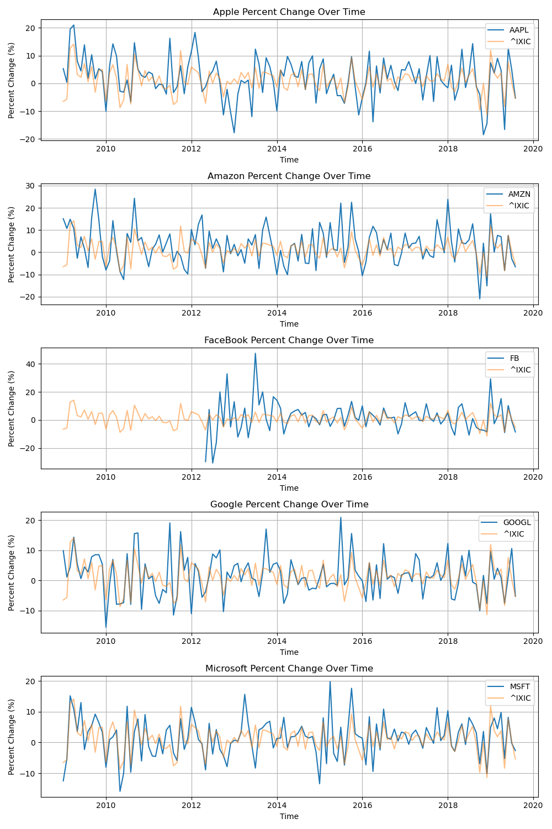
Question One trends over the last 10 years
Problems
Calculated percent change for all stocks
Had to separate the stocks into their own dataframes
Created 5 separate subplots that compares each stock to the NASDAQ index
Formatted titles and labels for each subplot
Initially tried all stocks compared on one graph together, but we were not able to get any insights visually from that setup
Insights
Ax plot (5 subplots)
Formatting

Slide 6
Question One Analysis

Slide 7
Question two Are there yearly events that contribute to stock volatility?

Slide 8
Question three Are there general good times to buy and sell the big 5 throughout the calendar year?

Slide 9
Question four Did the big 5 outperform or underperform the NASDAQ composite as a whole over the 10 year period?

Slide 10
Question five Of all the shares bought in the big 5, who had the most shares bought over the last 10 years?

Slide 11
Question six What are the closing prices for the big 5 going to be on Aug 31st 2020?

Slide 12
Analysis

Slide 13
Conclusions

